Slide 1
Intelligence Myths
Elliot Greenlee, Nathan Harner, Matthew Mascioli,
Sikai Wang, Sabrina Williamson

Slide 2


Academic performance is based on intelligence

Slide 3
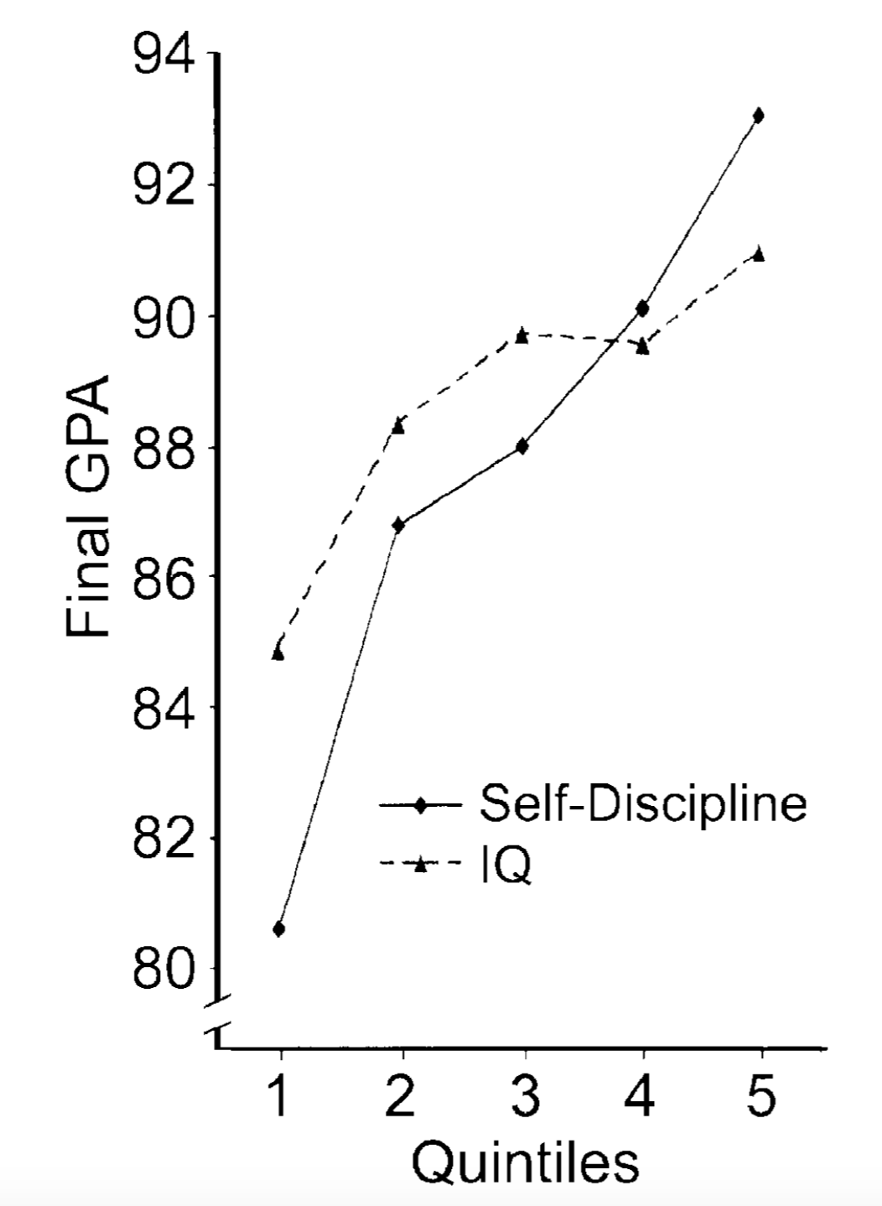

Slide 4


Slide 5
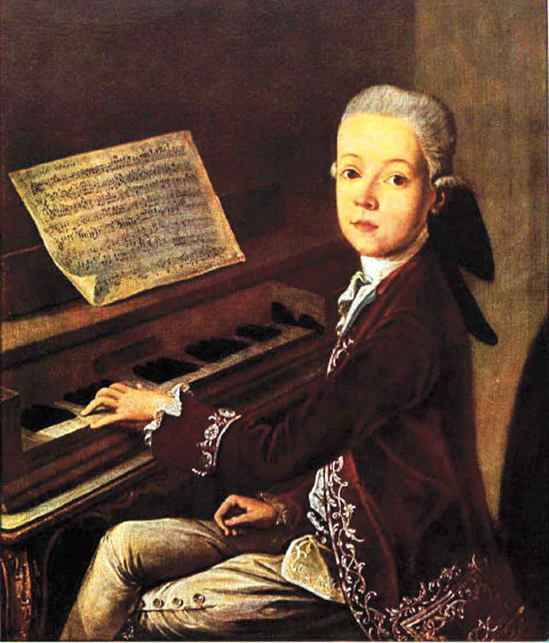

The Myth of Prodigy

Slide 6


Slide 7
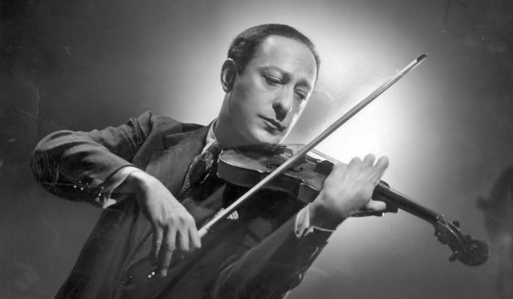

Slide 8


Do Genetics determine our Intelligence?

Slide 9


Slide 10


Slide 11

Minority groups score less on standardized tests/do worse in school than other groups

Slide 13


Slide 14

Are males better at math and science than females?

Slide 15


Slide 16


